Slide 1

Food Trends Understanding Customer Preferences
Infosys Springboard Internship Batch 11
Data Visualization Domain
Mentor:
Ms. Nityasree
Presented by :
Flemin P Daniel
Team D

Slide 2

Objective and Project Description
Objective
• Leverage Power BI to analyze transactional and customer feedback data in the food and beverage industry
• Enable data-driven decision-making to address evolving customer preferences and operational inefficiencies
Project Description
• Identify emerging food trends and optimize menu planning based on demand and revenue performance
• Analyze customer demographics, ordering behavior, pricing sensitivity, and loyalty patterns across key cities

Slide 3

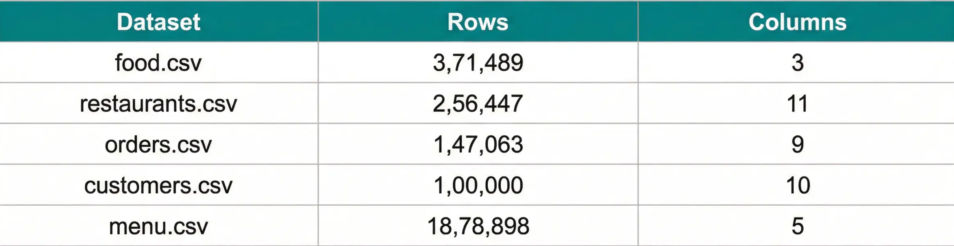
Dataset Overview
Five core datasets from Kaggle Zomato Database forming the foundation for multi-dimensional analysis across geography, demographics, and time
Key Attributes Enable:
• Customer demographic and behavioral segmentation (Age, Gender, Income, Occupation) • Location-based and quality analysis (City, Cuisine, Ratings, Cost) • Transactional timing, volume, and value tracking (Order_Date, Amount_Ruppers) • Food item characteristics and pricing analysis (Item, Veg_or_NonVeg, Price)
Total Records: 25,63,897

Slide 4

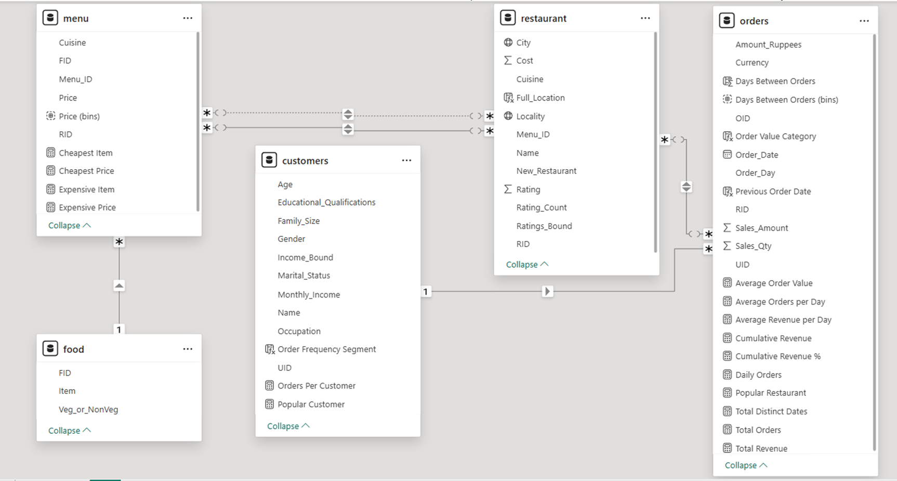
Data Model

Slide 5

Milestone 1: Data Foundation
Objective:
Collect data and perform preprocessing
Scope:
insights via Power BI dashboards
Dataset:
5 tables — food, restaurants, orders, customers, menu
Comprehensive preprocessing ensured data quality and analytical accuracy across all five datasets

Slide 6
Milestone 2: Business Overview
Developed three pages namely
Business Snapshot, Customer Analysis, Restaurant Performances
KPIs: 147K orders, 12K restaurants, ₹964M revenue
City-wise performance & contribution
Highlights: top cities, outliers

Slide 7
Milestone 3: Ordering Behavior
Developed two pages namely
Food and Menu Trends, Ordering Insights
Customer preferences: timing, channel, repeats
Popular items & bundles
Cuisine performance: sales, margin, growth

Slide 8
Milestone 4: Customer Demographics
Demographics: age, city, segments
Loyalty patterns: cohorts, repeat rate
Operations: peak hours, delivery time, cancellations
Strategic signals: opportunities & risk

Slide 9




Challenges Faced and Resolution
Addressed data inconsistencies, multi-valued fields, and missing metrics through cleaning, transformation, and enrichment, ensuring analytical accuracy and reliability
Data Cleaning
Data Transformation
Data Enrichment
Challenge: Inconsistent formatting and null values in critical columns (Rating, City, Cuisine)
Challenge: Inconsistent formatting and null values in critical columns (Rating, City, Cuisine)
Challenge: Inconsistent formatting and null values in critical columns (Rating, City, Cuisine)
Challenge: Multi-valued Cuisine and City fields, ambiguous Menu_ID and RID relationships
Challenge: Multi-valued Cuisine and City fields, ambiguous Menu_ID and RID relationships
Challenge: Multi-valued Cuisine and City fields, ambiguous Menu_ID and RID relationships
Challenge: Currency inconsistency (INR/USD), lack of day-of-week data, incomparable ranges
Resolution: Text trimming, duplicate removal, created New_Restaurant column for null ratings
Resolution: Text trimming, duplicate removal, created New_Restaurant column for null ratings
Resolution: Text trimming, duplicate removal, created New_Restaurant column for null ratings
Resolution: Split and unpivot multi-valued fields, explicit relationship definitions in Power BI
Resolution: Split and unpivot multi-valued fields, explicit relationship definitions in Power BI
Resolution: Split and unpivot multi-valued fields, explicit relationship definitions in Power BI
Resolution: Created Amount_Rupees, Order_Day, and Income_Bound columns for unified analysis
Comprehensive data preprocessing ensured reliable foundation for accurate business intelligence analysis

Slide 10



Key Insights and Feature Enhancement
Strategic Insights
Strategic Recommendations
• Revenue declined from ₹41.75M (2018) to ₹14.59M (2020)
• Launch 'Weekend Family Bundles' for low-performing days
• Friday peak: 34.5K orders vs. weekend drops
• Implement 'Student Prime' Loyalty Program
• Students drive highest revenue despite low income
• Expand into Tier-2 cities (Raipur, Hyderabad)
• Quality perception matters more than price
• Incentivize user reviews with discount campaigns
Data-driven strategies to reverse declining trends and enhance customer retention

Slide 11
Acknowledgement
We would like to express our heartfelt gratitude to:
Infosys Springboard Team– for organizing this valuable internship opportunity.
Our Mentor– for her continuous support and feedback.
My Teammates – for collaboration, encouragement, and insights This internship has been a significant step in our professional growth and technical journey.

Slide 12



Conclusion
• Successfully transformed raw transactional data into comprehensive and interactive visual dashboards
• Delivered actionable insights into food trends, customer preferences, and operational patterns
• Enabled deep understanding of customer behavior, revenue drivers, and market dynamics
Data-driven approach transforms business intelligence into competitive advantage

Slide 13


Reference
All data, analysis, and insights presented in this report are based on internal project documentation provided, including:
Kaggle Zomato Dataset
Microsoft Power BI Documentation
Infosys Springboard Virtual Internship course materials

Slide 14
Thank You

